Slide 1

CIT-2180 Data and Database Management Chapter 4

Slide 2

Oracle 12c: SQL
Chapter 4
Constraints

Slide 3
Constraints
Rules used to enforce business rules, practices, and policies
Rules used to ensure accuracy and integrity of data

Slide 4
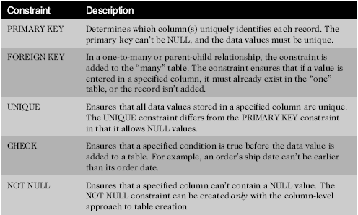
Constraint Types

Slide 5
Enforcement of Constraints
All constraints are enforced at the table level
Constraints are enforced when adding a new row (insert) or modifying an existing row (update).
If a data value violates a constraint, the entire row (insert or update) is rejected
Special case: Referential integrity is enforced if deleting a row from the parent of a one-to-many relationship.

Slide 6
Creating Constraints
Constraints can be named (preferred). Use the optional CONSTRAINT keyword during creation to assign a descriptive name
Optionally, let the server name the constraint using the default format SYS_Cn
Informative names can assist in debugging.
Example PK: customers_customer#_pk
Example FK: orders_customer#_fk

Slide 7
Creating Constraints (continued)
When (2 options)
During table creation
After table creation, by modifying the existing table
How (2 options)
Column level approach (syntax)
Table level approach (syntax)

Slide 8
Creating Constraints at the Column Level
If a constraint is being created at the column level, the constraint applies to the column specified

Slide 9
Creating Constraints at the Table Level
Approach can be used to create any constraint type except NOT NULL
Required if constraint is based on multiple columns

Slide 10
Adding Constraints to Existing Tables
Constraints are added to an existing table with the ALTER TABLE command
Add a NOT NULL constraint using MODIFY clause
All other constraints are added using ADD clause
NOTE: Constraints can also be added at table creation time.

Slide 11
Using the PRIMARY KEY Constraint
Ensures that the data in the specified column(s) have two characteristics:
Do not contain duplicates (UNIQUE)
Do not contain NULL values
Only one per table is allowed

Slide 12
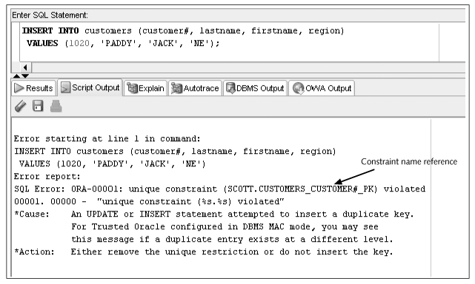
Constraint Checked with Data Input

Slide 13
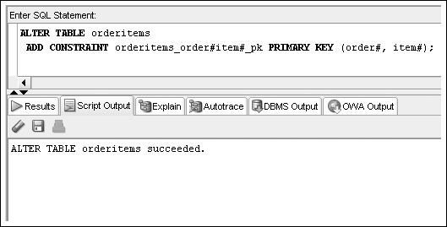
PRIMARY KEY Constraint for Composite Key
A key composed of more than one column

Slide 14
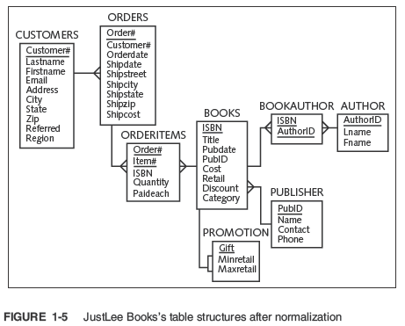

Slide 15
Using the FOREIGN KEY Constraint
Requires a value to exist in the referenced column of another table (the parent table)
NULL values are allowed (in the child table)
Enforces referential integrity
Maps to the PRIMARY KEY in parent table

Slide 16
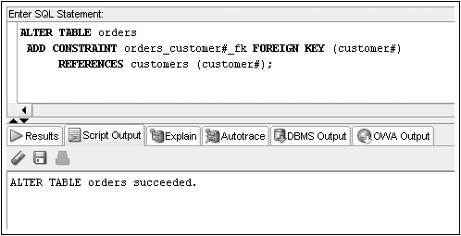
FOREIGN KEY Constraint Example

Slide 17
Deletion of Foreign Key Values
You cannot delete a value in a parent table referenced by a row in a child table
Use ON DELETE CASCADE keywords when creating FOREIGN KEY constraint – it automatically deletes all child rows when the row in a parent table is deleted

Slide 18
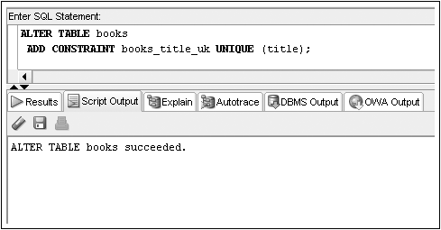
Using the UNIQUE Constraint
No duplicates are allowed in the referenced column
NULL values are permitted

Slide 19
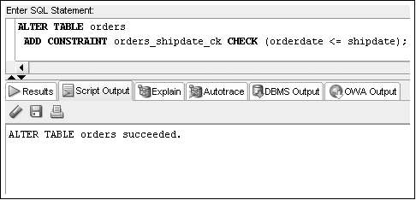
Using the CHECK Constraint
Updates and additions (insert) must meet specified condition (see page 118).

Slide 20
Using the NOT NULL Constraint
The NOT NULL constraint is a special CHECK constraint with IS NOT NULL condition
Can only be created at column level
Included in output of DESCRIBE command
Can only be added to an existing table using ALTER TABLE…MODIFY command

Slide 21
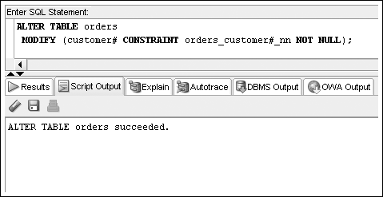
NOT NULL Constraint Example

Slide 22
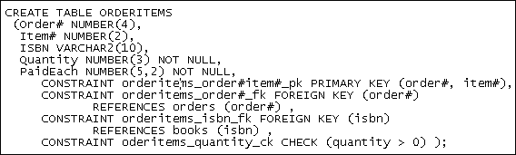
Multiple Constraints / Single Column
A column may be included in multiple constraints
The order# column is included in a primary key and a foreign key constraint

Slide 23
Dropping Constraints
Constraints cannot be modified; they must be dropped and recreated
Actual syntax depends on type of constraint
PRIMARY KEY – just list type of constraint
UNIQUE – include column name
All others – reference constraint name

Slide 24

ALTER TABLE…DROP Syntax

Slide 25
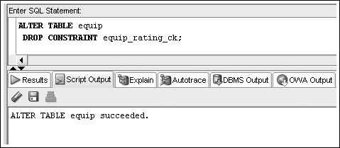
Drop Constraint Example

Slide 26
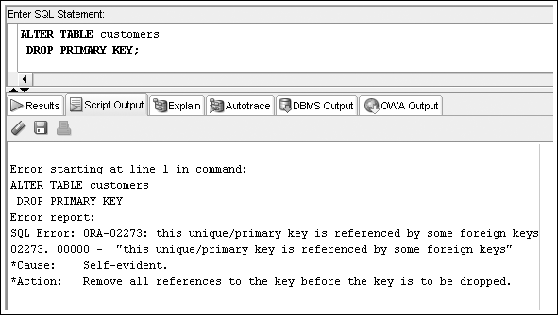
Drop Constraint Example – Error

Slide 27
Oracle 12c: SQL
END OF Chapter 4
Constraints

